Slide 1


IMPLEMENTATION OF SHOR’S ALGORITHM: QUANTUM FACTORIZATION
PRESENTATION
Presented By:
MADDULA KARTHIK – CH.SC.U4CSE23121
MUGIL AAKASH – CH.SC.U4CSE23130
RAM PREETAM – CH.SC.U4CSE23153

Slide 2
01
INTRODUCTION
Quantum computing uses quantum bits (qubits) that can exist in superposition and entanglement.
Classical computers struggle with integer factorization for large numbers.
Shor’s Algorithm, introduced by Peter Shor (1994), can factor large numbers exponentially faster than classical algorithms.

Slide 3
02
MOTIVATION
RSA encryption relies on the difficulty of factoring large numbers.
Shor’s algorithm demonstrates that quantum computers can break RSA encryption in theory.
Useful in cryptography, quantum computing research, and understanding quantum advantage.

Slide 4

WORKING PRINCIPLE
Pick a number N to factor.
Choose a random number a such that 1<a<N
Find the period r of f(x)=ax mod N using a quantum subroutine.
Compute GCDs:
03
gcd (a^r/2−1 , N) gcd (a^r/2+1,N)
to get the factors.

Slide 5
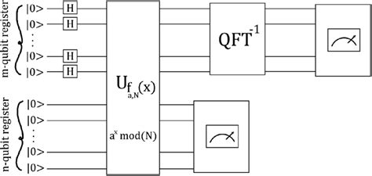
04
QUANTUM CIRCUIT OVERVIEW
CONTROL REGISTER: HOLDS SUPERPOSITIONS FOR PHASE ESTIMATION.
WORK REGISTER: PERFORMS MODULAR EXPONENTIATION.
QUANTUM FOURIER TRANSFORM (QFT): EXTRACTS THE PERIOD.
MEASUREMENT: OBSERVES THE CONTROL REGISTER TO FIND R.

Slide 6
IMPLEMENTATION IN QISKIT
Use Python + Qiskit to simulate Shor’s algorithm.
Backend: Aer simulator (qasm_simulator).
Algorithm: Shor from qiskit.algorithms.factorizers.
Example: Factorizing 15 → Output: [3, 5].
05

Slide 7
06
APPLICATIONS
Cryptography: Can theoretically break RSA and ECC.
Quantum Advantage: Solves factoring exponentially faster than classical methods.
Education & Research: Learn quantum concepts and simulate algorithms.
Post-Quantum Security: Helps design quantum-resistant cryptography.

Slide 8
LIMITATIONS
Hardware Needs: Requires many stable qubits; current hardware is limited.
Simulation Limits: Works only for small numbers on classical simulators.
Error Sensitivity: Quantum Fourier Transform errors may give wrong results.
Practical Use: Cannot break real-world encryption yet.
07

Slide 9
08
CONCLUSION
Shor’s algorithm shows quantum computing’s power in factoring large numbers.
Enables learning and experimentation using simulators like Qiskit.
Highlights need for post-quantum cryptography for future security.
Full potential awaits advanced quantum hardware.

Slide 10
THANK YOU
WRAPPING UP AND PARTING THOUGHTS

